Slide 1
denso hackathon
RelAI
RELIABLE AI RELAY SYSTEM FOR EV CHARGING

Slide 2
Problem.
Inconvenient charging
Lack of charging stations
Occupied charging stations
RELAI
CONFIDENTIAL

Slide 3
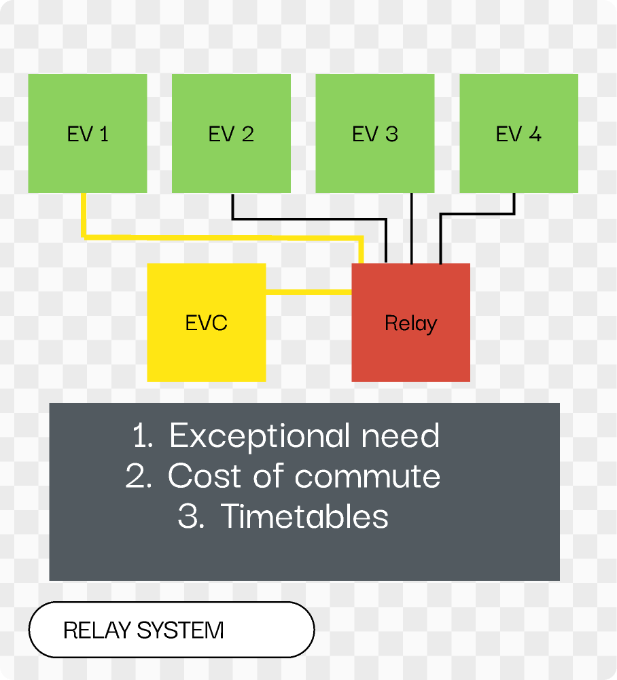
OUR PRODUCT
RelAI
AI-powered automatic relay systems to efficiently divide charge among EVs based on employees’ information.
RELAI
CCP
CONFIDENTIAL
CONFIDENTIAL
Notes:
l

Slide 4

OUR PRODUCT
RelAI
AI-powered automatic relay systems to efficiently divide charge among EVs based on employees’ information.
RELAI
CCP
CONFIDENTIAL
CONFIDENTIAL
Notes:
l

Slide 5

OUR PRODUCT
RelAI
AI-powered automatic relay systems to efficiently divide charge among EVs based on employees’ information.
RELAI
CCP
CONFIDENTIAL
CONFIDENTIAL
Notes:
l

Slide 6
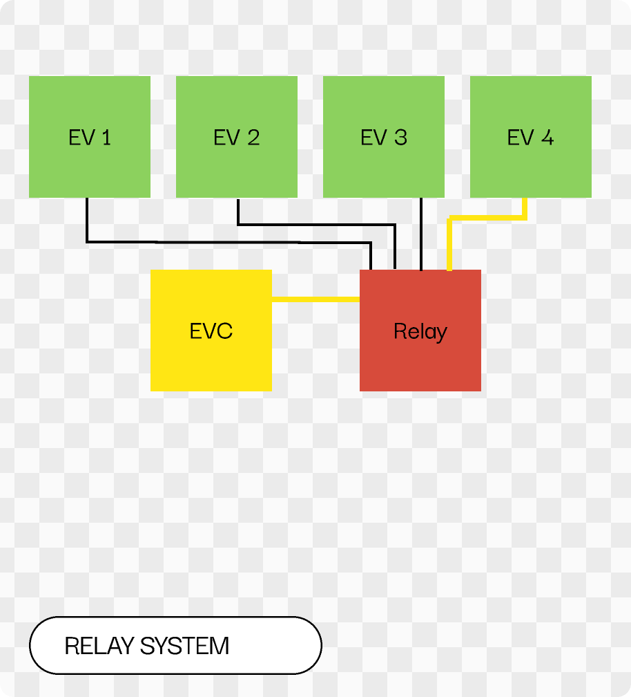

OUR PRODUCT
RelAI
AI-powered automatic relay systems to efficiently divide charge among EVs based on employees’ information.
RELAI
CCP
CONFIDENTIAL
CONFIDENTIAL
Notes:
l

Slide 7
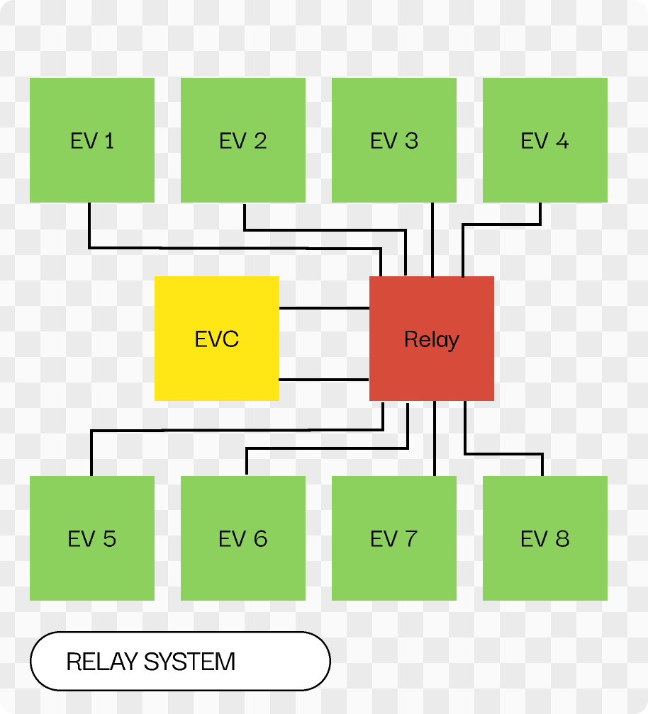
OUR PRODUCT
RelAI
AI-powered automatic relay systems to efficiently divide charge among EVs based on employees’ information.
RELAI
CCP
CONFIDENTIAL
CONFIDENTIAL
Notes:
l

Slide 8


HOW IT WORKS
1
Camera reads license plate
RELAI
CCP
CONFIDENTIAL
CONFIDENTIAL

Slide 9


HOW IT WORKS
2
Relay
Camera tracks car location
RELAI
CCP
CONFIDENTIAL
CONFIDENTIAL

Slide 10

HOW IT WORKS
3
Initial charge
Relay
AI algorithm divides charge
RELAI
CCP
CONFIDENTIAL
CONFIDENTIAL

Slide 11
HOW IT WORKS
4
Initial charge
Cost of commute
Relay
All cars are compensated for the cost of their commute
RELAI
CCP
CONFIDENTIAL
CONFIDENTIAL

Slide 12
HOW IT WORKS
5
Initial charge
Cost of commute
Relay
Excess
The rest of the charge is divided equally
RELAI
CCP
CONFIDENTIAL
CONFIDENTIAL

Slide 13
HOW IT WORKS
6
Initial charge
2
Cost of commute
1
Relay
Excess
3
4
The order by which EVs will be charged is based on employees’ schedule
RELAI
CCP
CONFIDENTIAL
CONFIDENTIAL

Slide 14
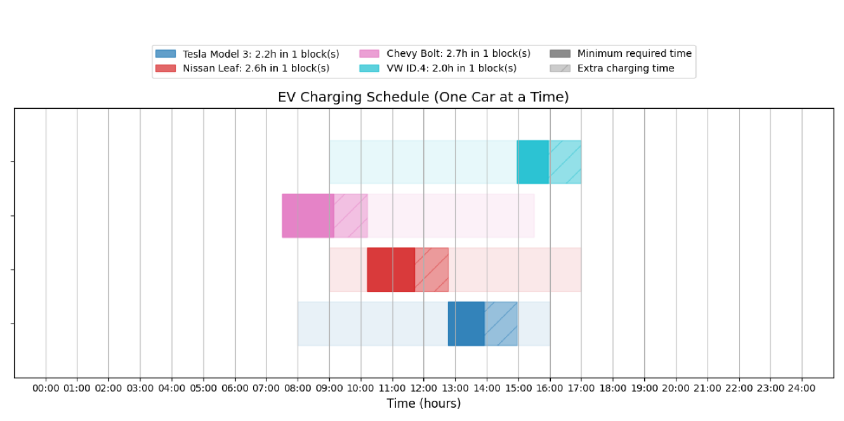
OUR PRODUCT
Scheduling algorithm
Schedule charge based on employees’ commute time, schedules, exception arrangements.

Slide 15

BUSINESS MODEL
Initial cost: 1000 €
Monthly subscription: 200-300 €
RELAI
CCP
CONFIDENTIAL
CONFIDENTIAL

Slide 16
Thank you
denso hackathon

